Slide 1
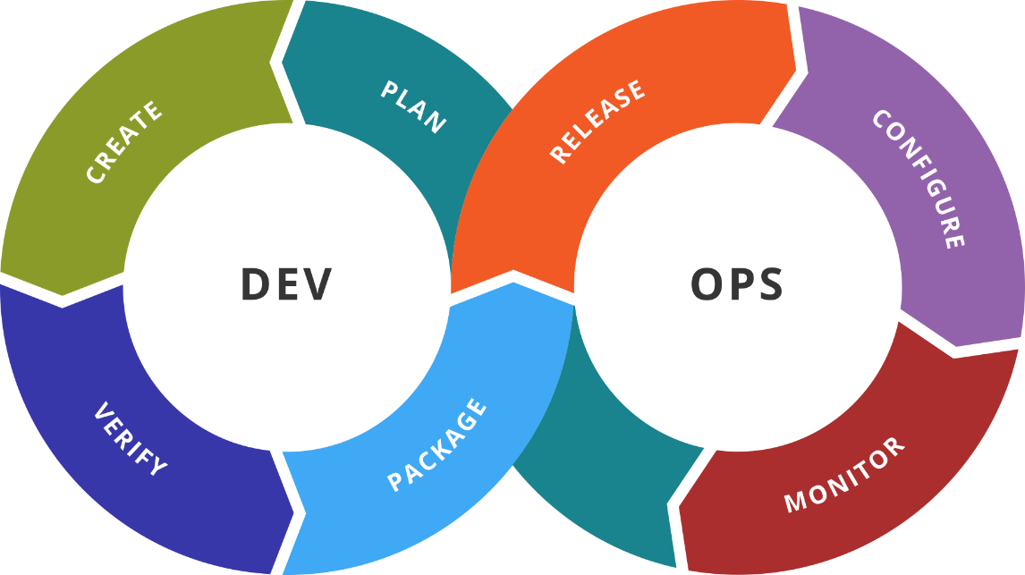
Jenkins
Introduction and Basic Techniques
SoftUni Team
Technical Trainers
Software University
https://softuni.bg

Slide 2
You Have Questions?
sli.do
#DevOps-23
facebook.com
/groups/DevOpsContainerizationCICDMonitoringJanuary2023

Slide 3
Homework Progress
Solutions for M3
can be submitted
until 23:59 on 22.02.2023
Solutions for M4
can be submitted
until 23:59 on 01.03.2023

Slide 4

Previous Module (M3)
Quick Overview

Slide 5
What We Covered
Advanced techniques
Networking
Volumes
Distributed Applications
Linking Methods
Docker Compose
Docker Clusters
Components and Principles
Docker Swarm

Slide 6

Dev
Ops
This Module (M4)
Topics and Lab Infrastructure

Slide 7
Table of Contents
Introduction to Jenkins
Working with Jenkins
Remote Tasks
Schedules
Plugins
Advanced Jenkins
Building with Docker
Pipelines

Slide 8
Lab Infrastructure
NETWORK: 192.168.99.0/24
.100
.101
VM1
Jenkins
VM2
Docker
VirtualBox
Vagrant
Windows / Linux / macOS

Slide 9
Dev
Ops
Available Solutions
For Continuous Integration/Deployment/Delivery

Slide 10
The Need
Speed
Build frequently and faster
Automation
Build and deploy in an automated fashion
Predictable results
Test each step and deploy only if everything is okay
Faster time-to-market
Possibility to deliver to production at any time

Slide 11
Solutions (1)
Buildbot
http://buildbot.net/
Free
TeamCity
https://www.jetbrains.com/teamcity/
Paid and Free. Cloud and On-Premise
Bamboo
https://www.atlassian.com/software/bamboo
Only paid

Slide 12
Solutions (2)
CircleCI
https://circleci.com/
Paid (offers basic free tier)
Travis CI
https://travis-ci.com/
Free (and Paid)
Jenkins (Backed by CloudBees)
https://jenkins.io/
Free (and Paid)
GitHub Actions
https://github.com/features/actions
Paid and free tier

Slide 13
Main Definitions
Continuous Delivery and Integration
CD is the ability to release at any time
CI is practice of integrating or merging code changes frequently
Stages of CD and CI
Build => Deploy => Test => Release

Slide 14
CD vs CD
Continuous Delivery
Software can be released to production at any time
Every change can go to production
I could be deploying constantly
Continuous Deployment
Software is released to production as part of an automated pipeline
Every change goes to production
I am deploying constantly

Slide 15
Dev
Ops
Introduction to Jenkins
Introduction. Components. Installation

Slide 16
What is Jenkins?
An open source automation server
A platform for the Software Development Life Cycle (SDLC)
Typically used to implement CI/CD
Easy to use and highly adaptable
Extensible and customizable
Works on most common operating systems
Considered lightweight

Slide 17
Key Definitions
Job
Configured task in Jenkins. It is an old term
Project
A task configured in Jenkins. It is the current term
Pipeline
Special type of job created by a Pipeline plugin

Slide 18
Requirements and Installation
Requirements
Works on Unix / Linux / Mac / Windows
Requires Java 11 or 17
Installation
Can be installed as a Native Service, Container, Java application
Can be installed from source or through package system
Current version
2.391 / 2.375.3
Weekly
LTS

Slide 19
Dev
Ops
Practice: Installation. Environment Setup
Live Demonstration in Class

Slide 20
Dev
Ops
Basic Activities
Remote Projects. Plugins. Schedules

Slide 21
Project Builds
Local and Remote
sudo allowance and settings
Remote credentials
User and Password, Key file
Firewall and SSH settings

Slide 22
Plugins
Default (minimal) set of plugins installed
Over 1800 plugins available at https://plugins.jenkins.io/
Grouped in categories by platform, purpose, etc.
Dedicated Plugin Manager
Automated or Manual installation

Slide 23
Scheduled Builds
With plugin or native
Two options
Execute once at a specific point in time
Regular execution
Execution interval is set with a cron like syntaxis

Slide 24
GitHub Integration
Offered trough a plugin
Installed by default
It works both with local git installation and GitHub
Local git client is required
Can receive notifications from git
Can check periodically for changes (should be avoided)

Slide 25
Dev
Ops
Practice: See It in Action
Live Demonstration in Class

Slide 26
Dev
Ops
Advanced Jenkins #1
Docker Integration. Pipelines

Slide 27
Docker Integration
Integration can be done trough plugin or directly
Docker client is required
Docker client should be present on all nodes where we plan to run Docker related tasks

Slide 28
Pipelines
Old name is workflows
Used for long running activity orchestration
Can span on multiple nodes (slaves)
It is a suite of plugins
“Pipeline as code” is defined with a Jenkinsfile

Slide 29
Jenkinsfile
It is used to define continuous delivery pipeline
Stored together with our code
Two styles are supported – declarative and scripted
It is written in Groovy

Slide 30
Declarative Jenkinsfile
It is required.
pipeline {
agents any
stages {
stage('Build') {
steps {
echo 'Step: Building...'
}
}
stage('Test') {
steps {
echo 'Step: Testing...'
}
}
stage('Deploy') {
steps {
echo 'Step: Deploying...'
}
}
}
}
Specify which agent to run the pipeline
or a stage. Can specify multiple nodes.
Mark the stages
Each stage describes a step in the SDLC
Steps are the actual work or
actions to take place.
They are similar to “Build Step”
in the Project Configuration view
Additional directives include: post, environment, triggers, and parameters

Slide 31
Dev
Ops
Practice: Slave Nodes and Docker
Live Demonstration in Class

Slide 32

Summary
Jenkins is an open source automation server
It could be installed in many ways
It is extendable through plugins
It is scalable – additional slave nodes could be added
There is integration with source control systems
Jenkins offers integration with Docker
Jenkins could be managed with systems like Ansible, Chef, and etc.
…
…
…

Slide 33
Resources
Jenkins site
https://jenkins.io/
Jenkins installation guide
https://jenkins.io/doc/book/installing/
Jenkins Pipeline guide
https://jenkins.io/doc/book/pipeline/
Managing Jenkins
https://jenkins.io/doc/book/managing/
Jenkins plugins
https://plugins.jenkins.io/
…
…
…

Slide 34
Questions?
Notes:
34

Slide 35














SoftUni Diamond Partners

Slide 36

Educational Partners

Slide 37

License
This course (slides, examples, demos, exercises, homework, documents, videos and other assets) is copyrighted content
Unauthorized copy, reproduction or use is illegal
© SoftUni – https://softuni.org
© Software University – https://softuni.bg
Notes:
37

Slide 38
Trainings @ Software University (SoftUni)
Software University – High-Quality Education, Profession and Job for Software Developers
softuni.bg, softuni.org
Software University Foundation
softuni.foundation
Software University @ Facebook
facebook.com/SoftwareUniversity
Software University Forums
forum.softuni.bg
Notes:
38

